Slide 1

LIBRARY MANAGEMENT SYSTEM
f
PREPARED BY: GUIDED BY: SARVESH SIR
SHUBHAM KUMAR (CS-23411362)
SUBHAM DAS (CS-23411069)
TANUJ KUMAR RAI (CS-23411444)

Slide 2
CONTENTS
INTRODUCTION
PURPOSE
PROJECT SCOPE
DISADVANTAGES OF EXISTING SYSTEM(IILM LIBRARY)
PROPOSED SYSTEM(LMS)
SYSTEM REQUIREMENTS
PRODUCT FUNCTIONS
MODULES(REGISTRATION,LIBRARIAN,FACULTY,STUDENT)
DIAGRAM(UML,USE CASE,SEQUENCE,ER)
SUMMARY
Q & A
THANK YOU

Slide 3

INTRODUCTION
A college library management is a project that manages and stores books information electronically according to students needs. The system helps both students and library manager to keep a constant track of all the books available in the library.
It allows both the admin and the student to search for the desired book. It becomes necessary for colleges to keep a continuous check on the books issued and returned and even calculate fine.
These errors are avoided by allowing the system to keep track of information such as issue date, last date to return the book and even fine information and thus there is no need to keep manual track of this information which thereby avoids chances of mistakes.
Thus, this system reduces manual work to a great extent allows smooth flow of library activities by removing chances of errors in the details.

Slide 4
PURPOSE
It provides “better and efficient ” service to members.
Reduce the workload of librarian
Faster retrieval of information about the desired book.
Provide facility for proper monitoring reduce paper work and provide data security.
Online Date and time zone system should be provided so that there is no confusion.

Slide 5

PROJECT SCOPE
Time and access can be obstacles to library research.
Readers must get to the library during library hours, which may not be convenient. They also may need to stay in the library for a long time to ensure they have exhausted all resources.
Some resources may not be available for checkout, which means the student must stay in the library to use them.
An online portal which can be accessed by faculty and students anytime.

Slide 6
DISADVANTAGES OF EXISTING SYSTEM (IILM LIBRARY)
The current time zone set in the library management system is not convenient to use.
Two times renewal in a month can be hectic for both librarian and student.
Mail for re-issuing the books is not received by students on their inbox. It goes in the spam folder.
Grace period is not visible in front end to the librarian.
Webpage lacks in design segment.
Online late fine payment collection link can’ t be send to student by the librarian.

Slide 7
Proposed System(LMS)
Proposed system is an automated Library Management System. Through our software user can add books, search books, renewal, update information, edit information, and return books in quick time.
Our proposed system has the following advantages.
Developed a well-organized book issue and searching system. Produced a well-designed and functioning system in accordance to the needs and wants of the students.
Minimized the task and the effort being performed by both the Librarian and students.
Provide the college and the students a well-organize and well-presented reports.
. User friendly interface
. Fast access to database
. Less error
. More Storage Capacity
. Look and Feel Environment
. Quick transaction
Introduce AI to system .

Slide 8
SYSTEM REQUIREMENTS
Hardware Requirements:
Operating system : Windows 8/10/11
Hard disk : 256GB or above
RAM : 8GB
Processor : Intel i3/i5/i7
Software Requirements:
Programming Languages:
Backend Development:
Java
Python
Frontend Development:
HTML
CSS
JavaScript
Database Management Systems (DBMS):
Relational Database Management Systems (RDBMS):
MySQL

Slide 9
PRODUCT FUNCTIONS
REGISTER NEW USER
REGISTER NEW BOOK
USER LOGIN
SEARCH BOOK
GENERATE REPORTS
ISSUE & RETURN BOOKS

Slide 10
MODULES
Registration Module
Librarian Module
Student Module
Faculty Module

Slide 11
REGISTRATION MODULE
Used for registration.
Registration can be done using college mail id.
Gets a confirmation message after registration.

Slide 12

Librarian Module
Have Unique ID and Password
Can access entire system.
Can add and remove books, journals and magazines.
Perform Transactions

Slide 13

FACULTY MODULE
Log in
Search for a book
View Book Detail
Know Availability of Book
Know due date of Borrowed book

Slide 14

STUDENT MODULE
Log in
Search for a book
View book detail
Know availability of book.
Know due date of borrowed book

Slide 15
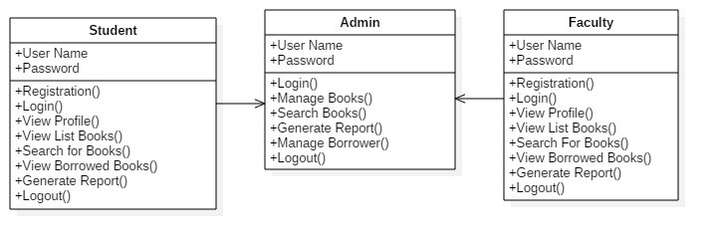
UML DIAGRAM

Slide 16
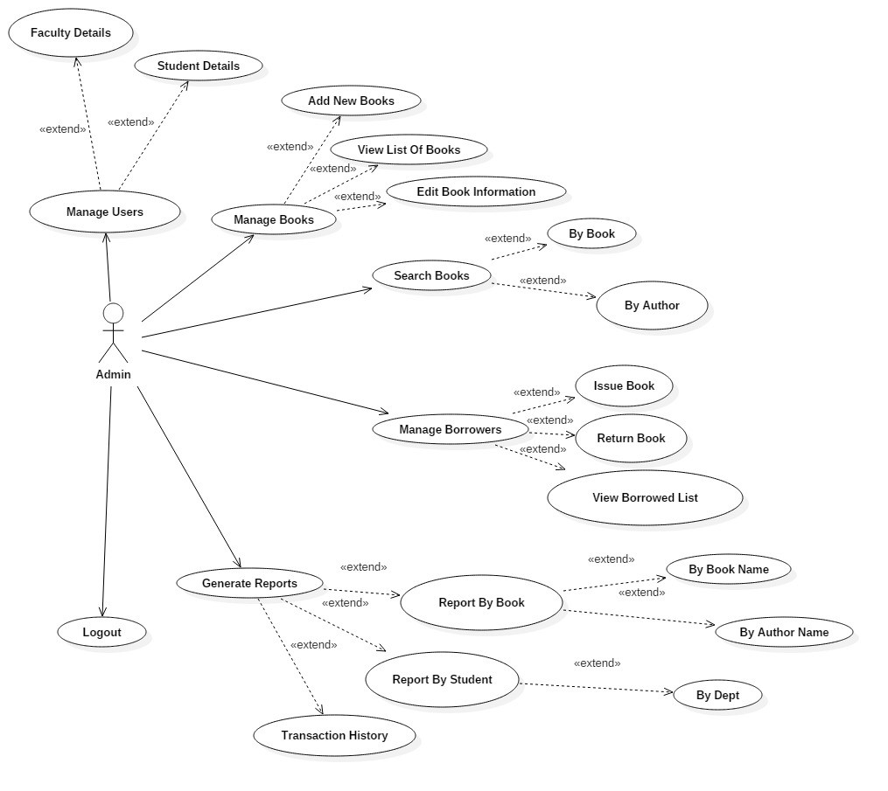
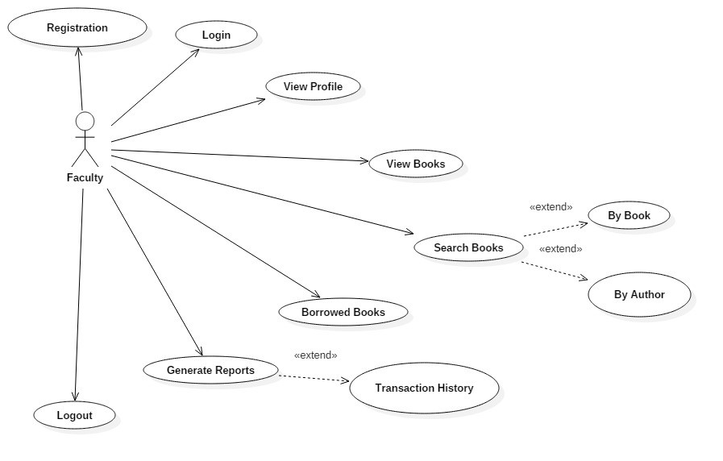
USE CASE DIAGRAM

Slide 17
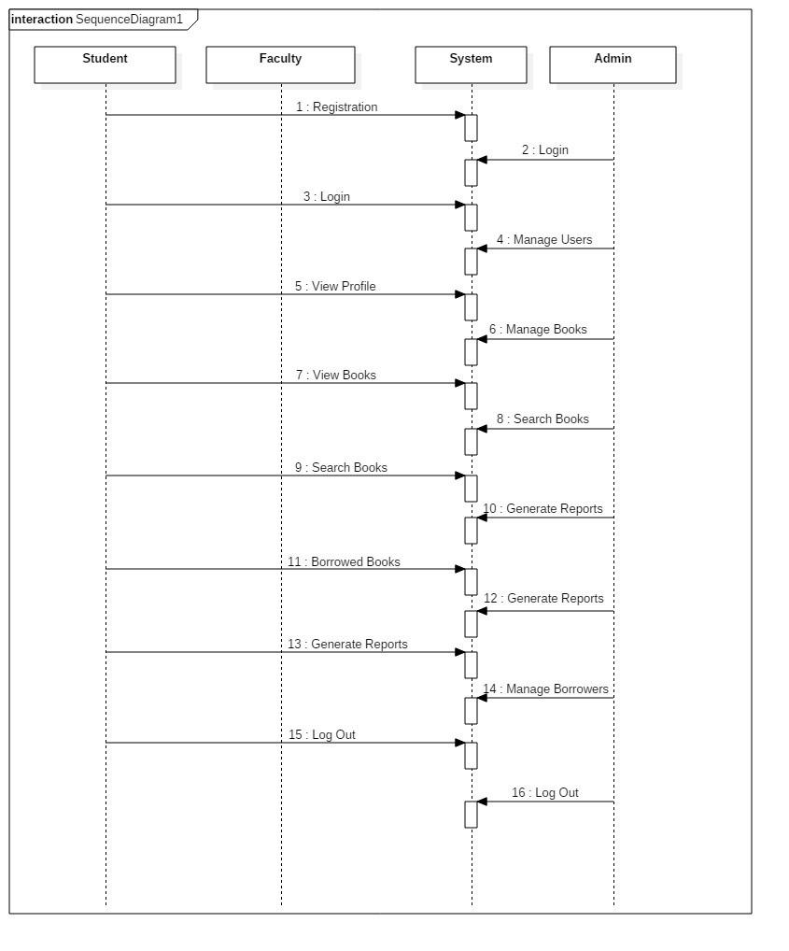
SEQUENCE DIAGRAM

Slide 18
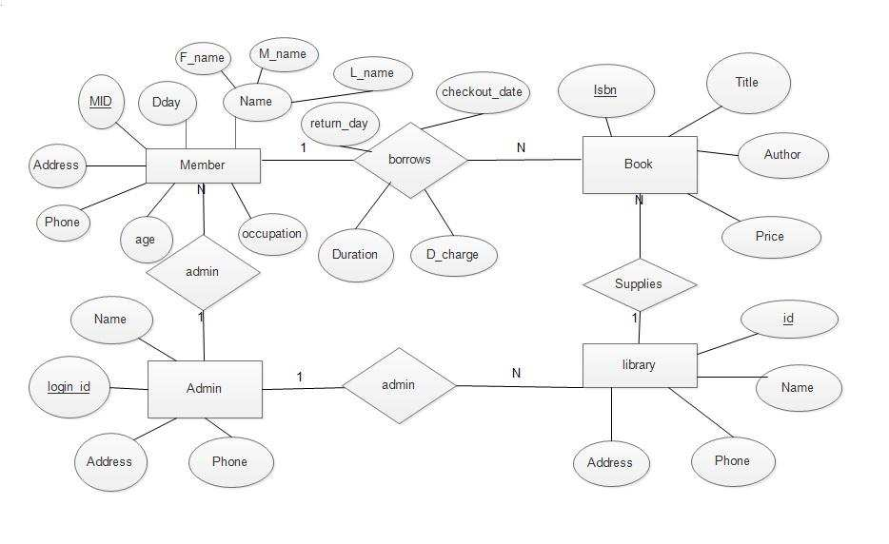
ER DIAGRAM

Slide 19
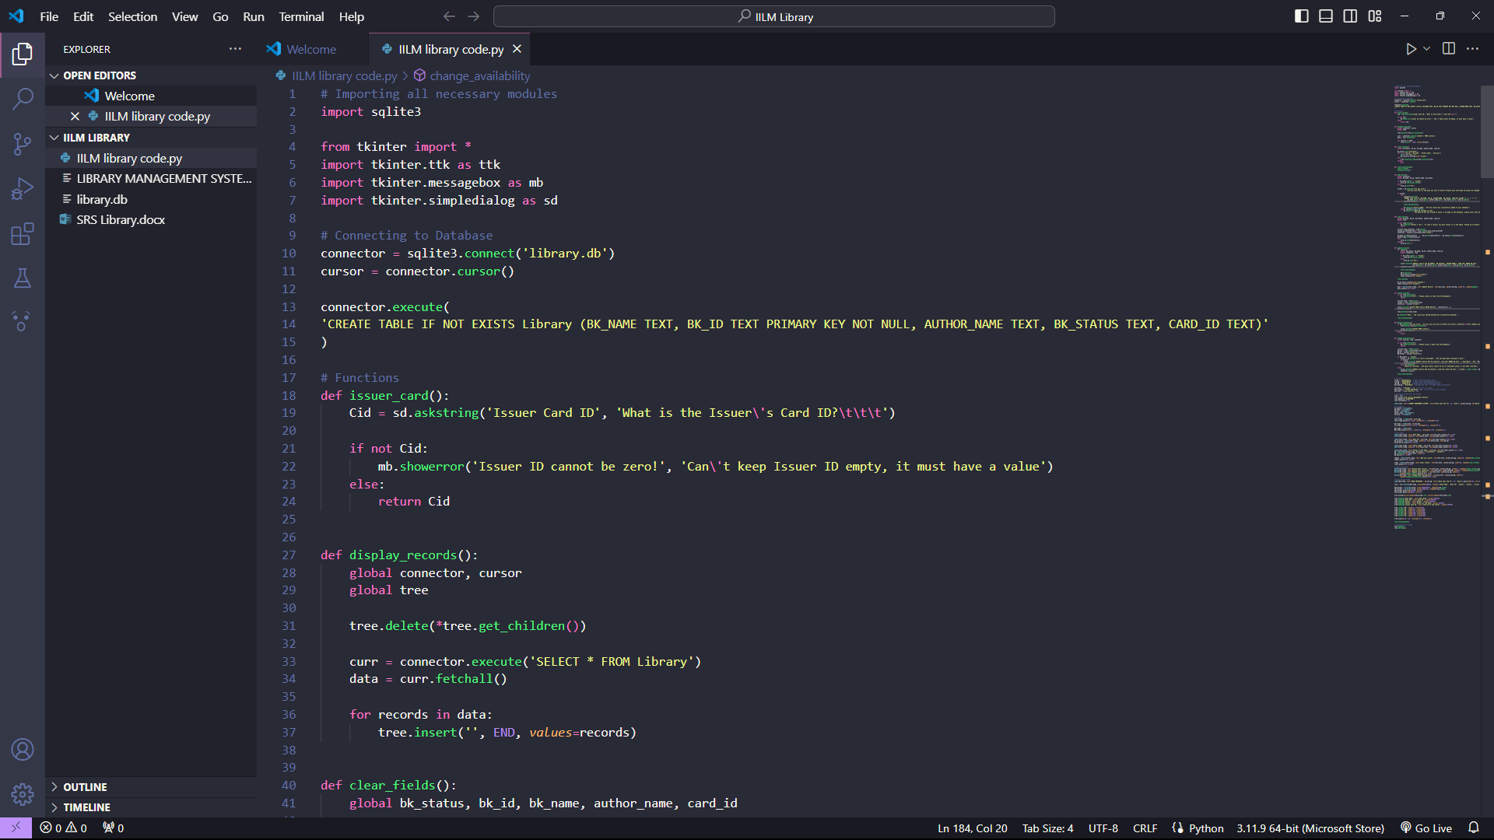
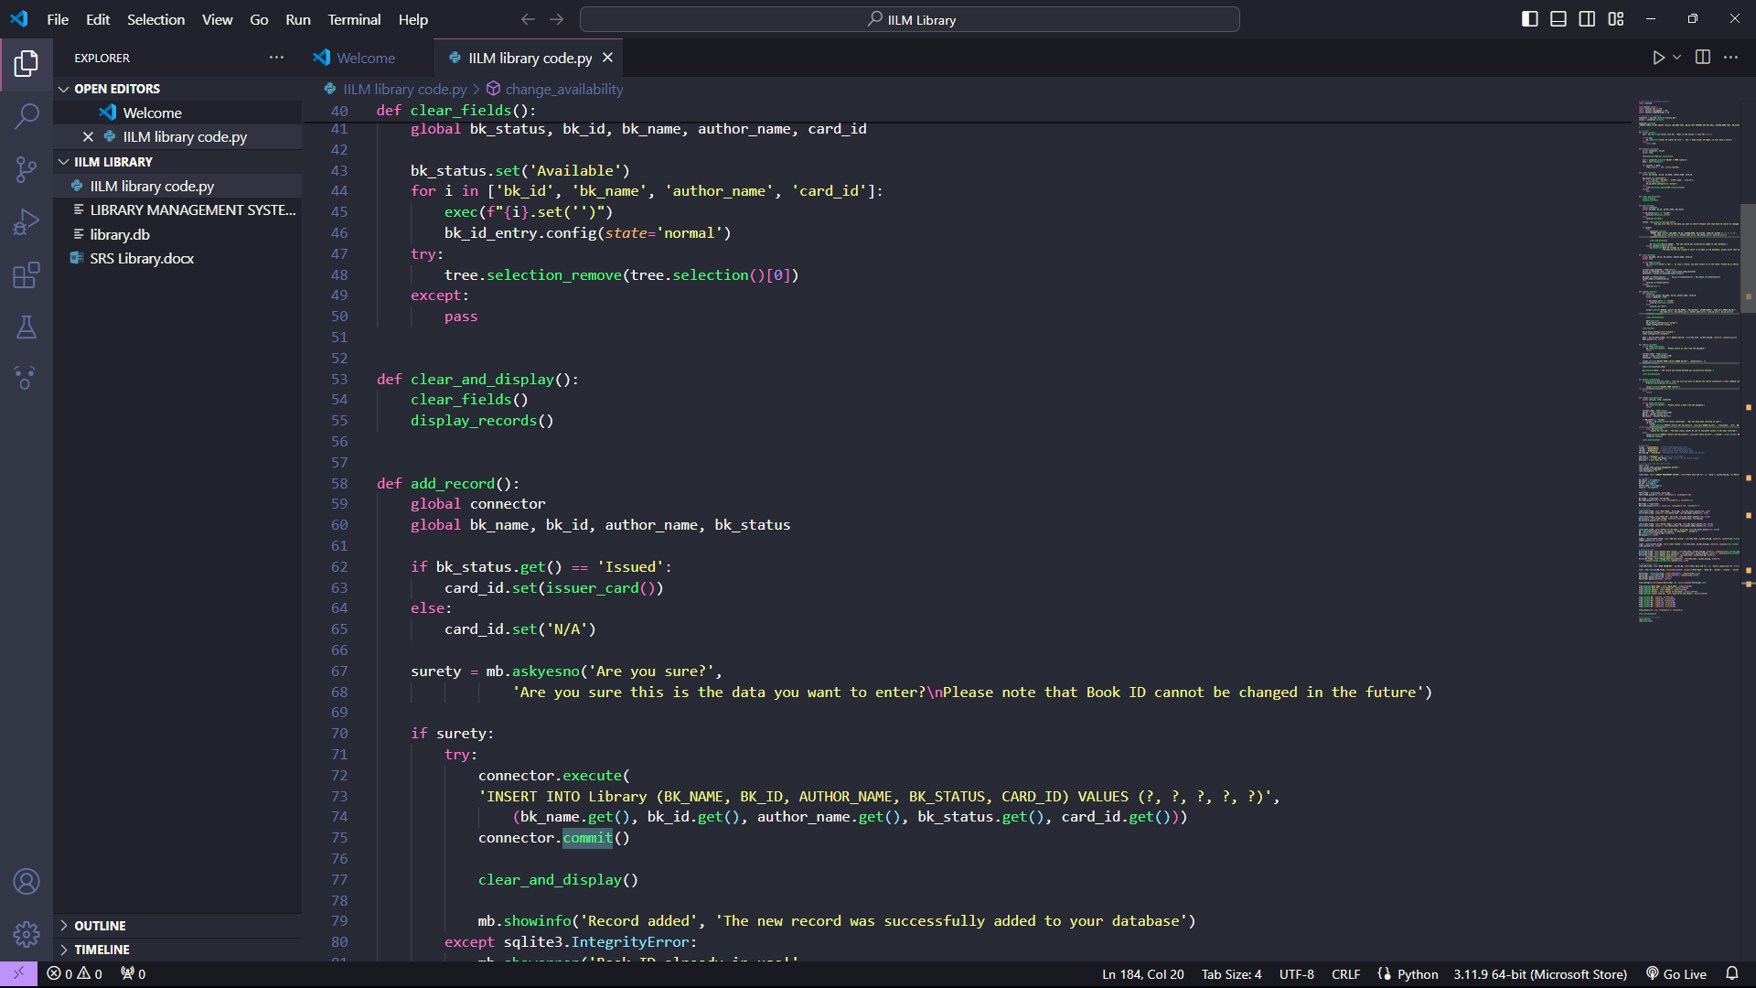
IMPLEMENTATION(CODING AND INTERFACE)

Slide 20
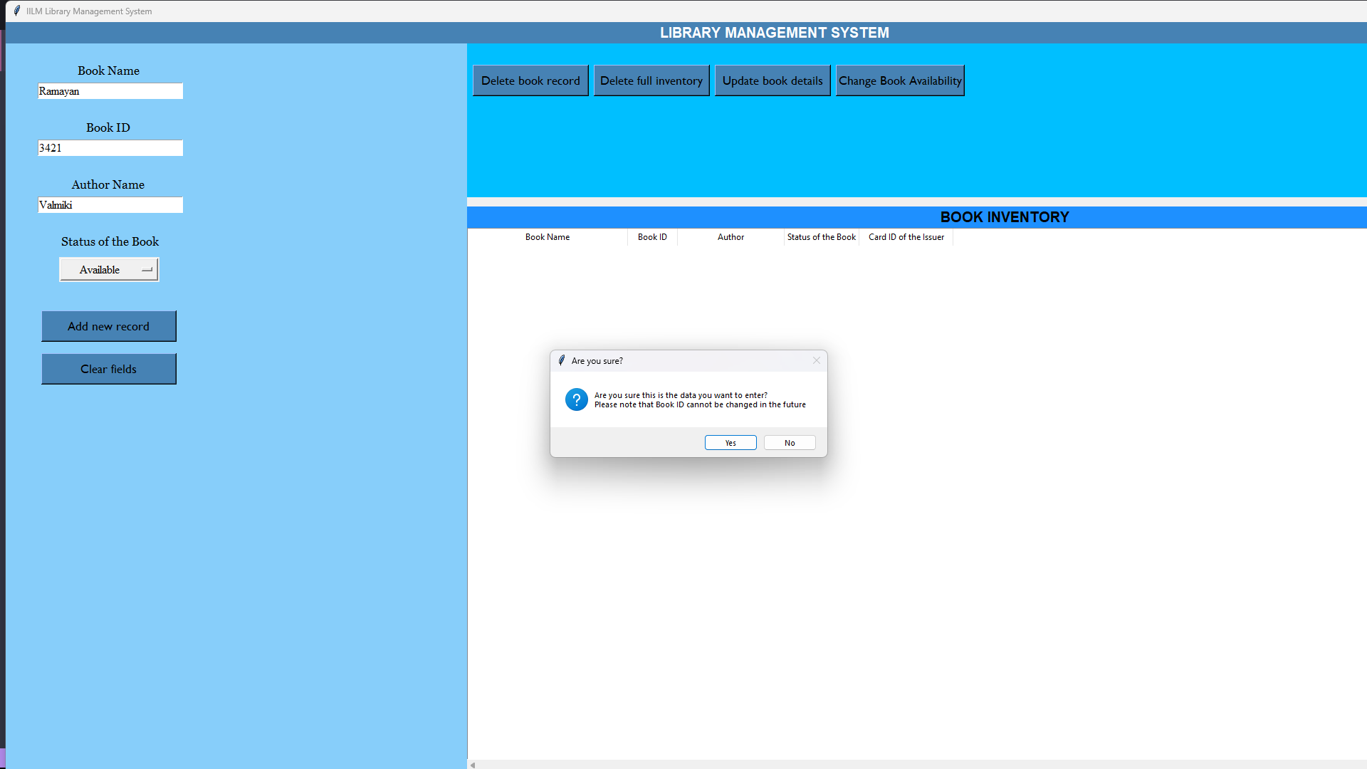
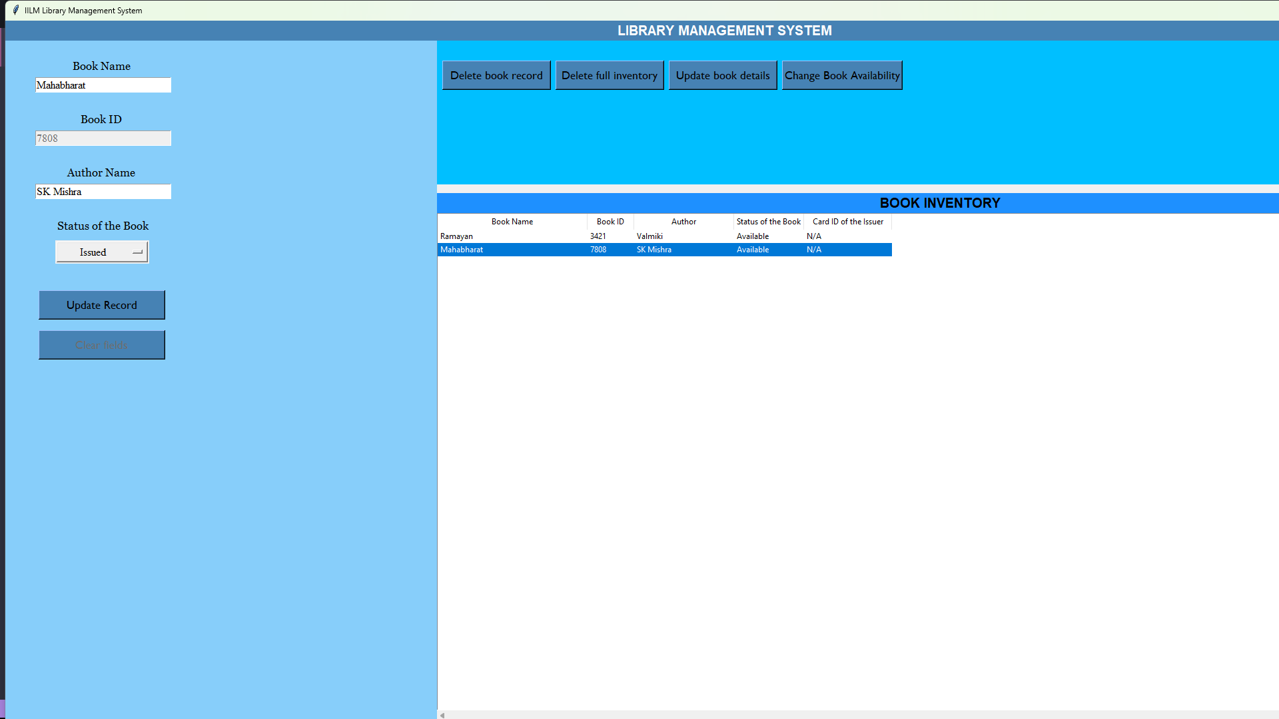
INTERFACE

Slide 21
SUMMARY
We conclude that our library management system present in college is outdated and it needs upgradation. Our proposed system is much more efficient and powerful as compared to present one.
Library is one of the integral part in an institute . Thus, we should modify it according to the new generation and make more suitable to use for everyone including faculty, librarian and students.

Slide 22

Q & A

Slide 23

THANK YOU

